Slide 1

Railway Reservation System

Slide 2
The Scenario
The Railway Reservation System is designed to facilitate passengers inquiring about available trains based on their source and destination, booking and canceling tickets, and checking the status of booked tickets. The objective of this case study is to develop a database that maintains records of different trains, their statuses, and passenger information. Train records include train number, name, source, destination, and availability on specific days. Train status records include dates for ticket bookings, the total number of available seats, and the number of seats already booked.

Slide 3
STEP 1
Passengers can book tickets for available trains by providing the desired train number and the booking date. The system validates the train number and booking date. If valid, it checks seat availability. If seats are available, the system books the ticket with a confirmed status and generates a unique ticket ID. The ticket ID is stored along with passenger details. Once all available tickets are booked, a certain number of tickets are booked with waiting status. If the waiting list is also full, the system displays a message indicating the unavailability of seats. Booked tickets can be canceled at any time by providing the unique ticket ID. The system searches for the ticket ID and deletes the corresponding record. As a result, the first ticket on the waiting list also gets confirmed.

Slide 4
STEP 2
Train Records would need to include:
Train number
Availability
Train status
Destination
Source

Slide 5
STEP 2
Booking Systems should have the following attributes:
Waiting List
Available seats
Ticket cancellation
Booking ID
Booking status
Booking date

Slide 6
STEP 2
Passenger details:
Passenger ID
Passenger Name
Passenger Email
Passenger number

Slide 7
STEP 2
Tickets:
ID
Ticket ID
Ticket price
Ticket category
Ticket date
Passenger ID

Slide 8
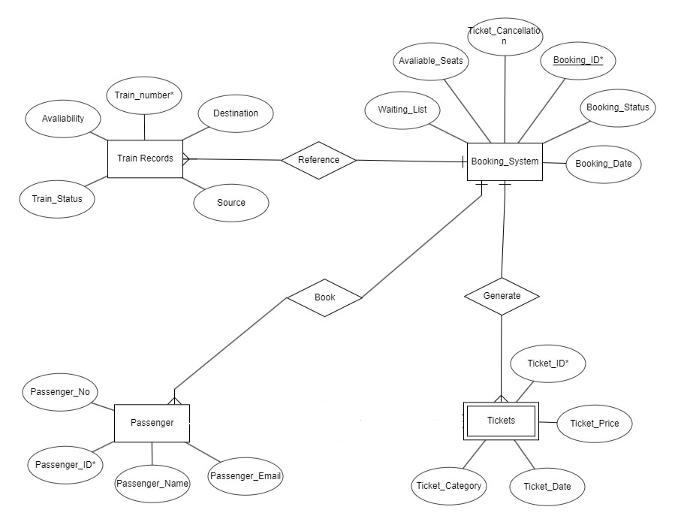

Slide 9
Train Records Table
Train_Number | Primary Key | varchar
Source_City | Only characters | varchar
Destination_City | Only characters | varchar
Availability | Only characters | enum

Slide 10
Passenger Table
Passenger_ID | Primary Key | Int
Passenger_Name | Only characters | varchar
Passenger_Email | Email address is required | varchar
Ticket_ID | characters and numbers | varchar

Slide 11
Tickets Table
ID | Primary Key | int
Ticket_ID | Numbers and characters | varchar
Ticket_Price | No negative | int
Ticket_Category | AC or General | enum
Ticket_Date | Date is required | varchar

Slide 12
Booking System Table
Book_ID | Primary Key | Int
Waiting_List | Passenger_Name & Waiting_List number required | Varchar
Number of seats required | Numbers only | Int
Ticket_Cancellation | Yes/No only | enum
Booking_Date | Date is required | Varchar
Booking_Status | Successful/Unsuccessful only | enum
Train Number | Foreign Key | varchar
ID | Foreign Key | int

Slide 13
DEFINE BUSINESS RULES
Booking is open for the next 7 days from current date.
Ticket price is subjected to changes (waiting list included).
Special requests (example, but not limited to, assistance dog, wheelchair, help with luggage).
Food requests (e.g. vegetarian, halal) has to be submitted upon successful booking and/or 24 hours before departure.

Slide 14
Assumptions
Number of trains limited to 5.
Booking is open for next seven days from the current date.
Two ticket categories: AC and General
Maximum number of tickets that can be booked in each category (AC and General) is 10.
Maximum number of tickets that can be placed on the waiting list is 2.
It is the travel season off peak, train capacity isn’t filled.

Slide 15
Initial ERD

Slide 16
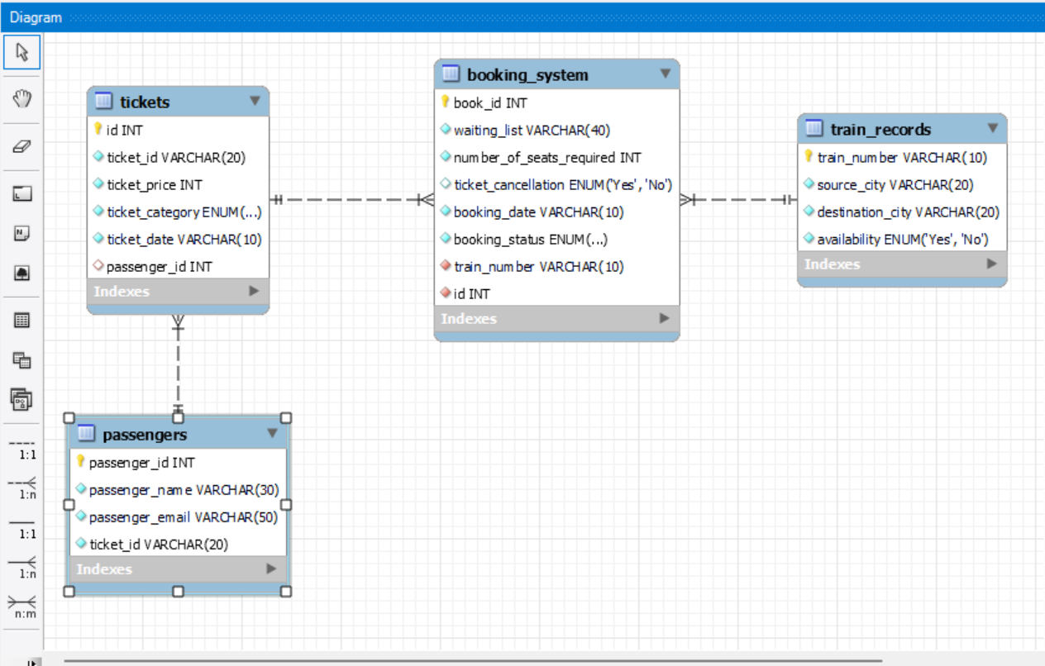
MySQL EER Diagram

Slide 17
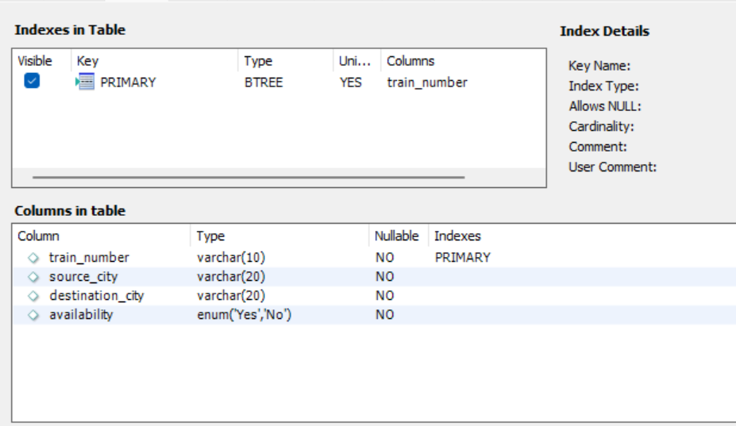
TRAIN RECORDS TABLE

Slide 18
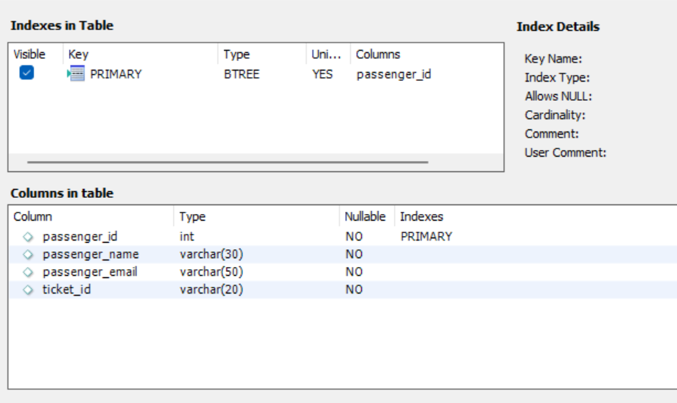
PASSENGERS TABLE

Slide 19
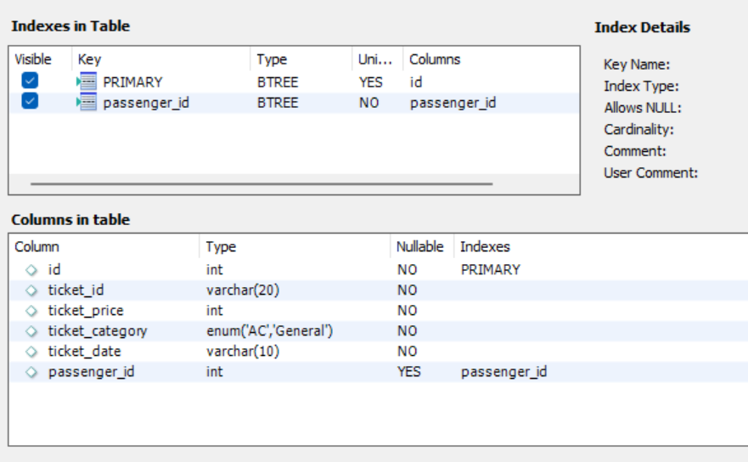
TICKETS TABLE

Slide 20
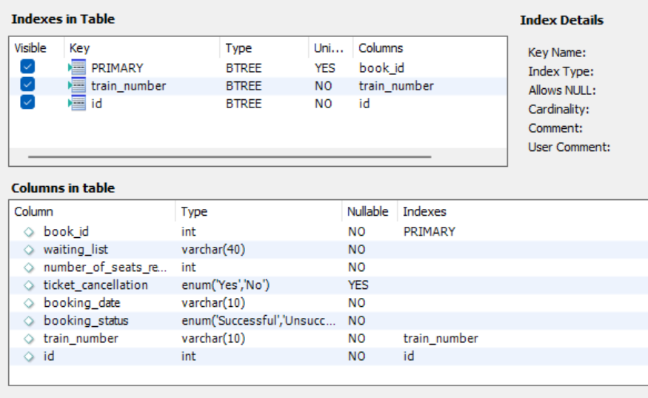
BOOKING SYSTEM TABLE

Slide 21
Questions
Get all rows from 'passenger' table
Get booking id and booking status from the table
Find ticket category
The details of the passenger named ‘Christy’ are required.
Find all bookings made from 15 Oct 2023 to 21 Oct 2023, both dates inclusive
What is customer Ben’s ticket ID?

Slide 22
Answers
select * from passengers;
select book_id, booking_status from booking_system;
select distinct ticket_category from tickets;
select passenger_name, passenger_id, passenger_email from passengers where passenger_name = 'Christy';
select book_id, booking_date, booking_status from booking_system where booking_date between '15/10/2023' and '21/10/2023';

Slide 23
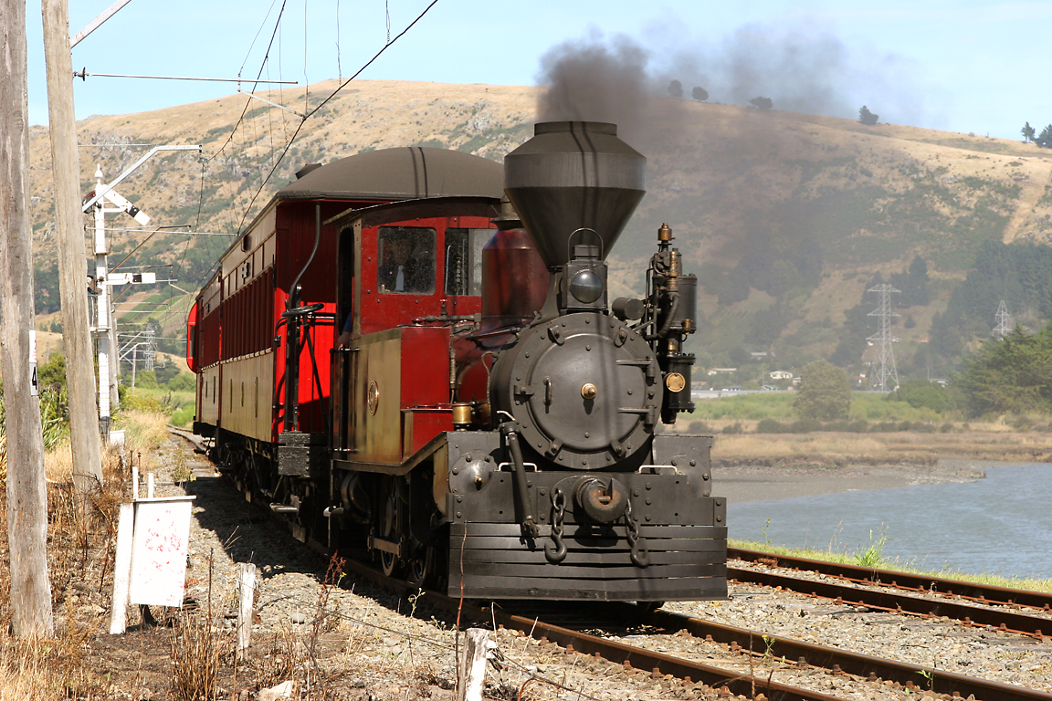
THE END

